Slide 1
Project Name:-ACCIDENT EMERGENCY INTELLIGENCE
Created by :- Darshit dobariya , Deep panseriya
- 170160116022 170160116055
- Information technology

Slide 2
Existing Problem
According to Times of India about 146,133 people were killed in road accidents in India in the year 2019.
Unfortunately about 30% of deaths are caused due to delayed ambulance.
This ratio of deaths can be decreased by our device because it will call the ambulance immediately.

Slide 3
work of the project
The system of our project is able to detect the happened accident automatically by itself.
After detecting it will verify if the people present in the particular vehicle are safe or not.
After the verification if the people are not safe the system will automatically call the ambulance.
It will share all the details of the accident including the location using voice call like any other human call.

Slide 4
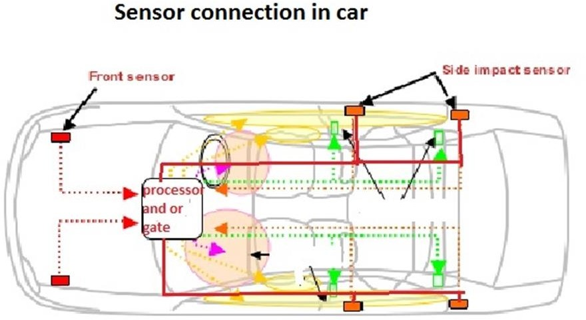
[implementation of shock sensor]

Slide 5
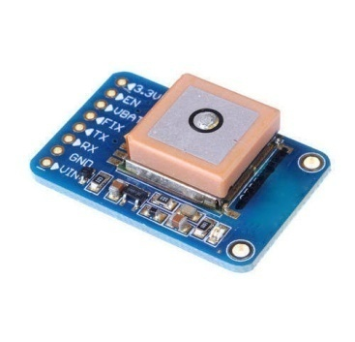
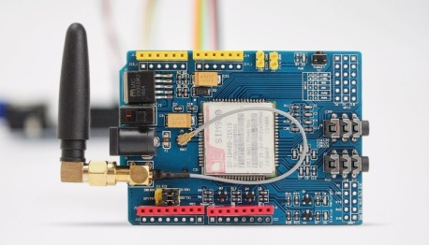
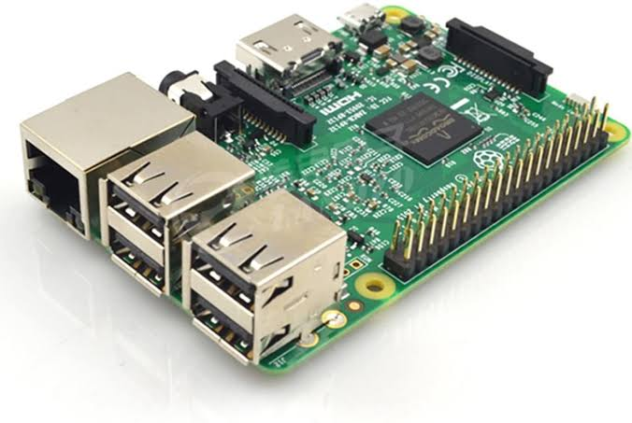

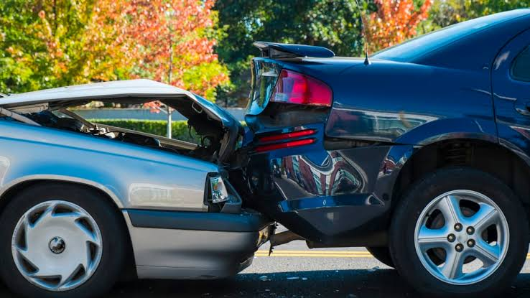
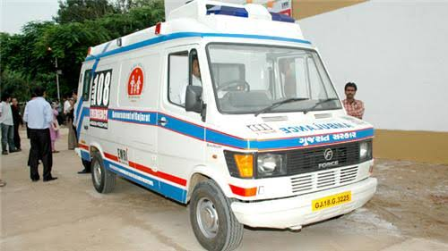
Working of the device
GPS used for
Spot accident
location
GSM Module Used For Send Message .
3
Our Device
4
2
Twilo API use
Call Ambulance and share Live Location.
Accident happen between cars
5
Ambulance
1
6

Slide 6
All the present sensors in the vehicle will be connected through the OR gate.
After getting command from the sensor device will ask the driver a particular question that ”ARE YOU OKAY ?”
After asking 3 times if there is no response from the driver , the following program will contact the twilio api and will share the GPS data.
After getting the data twilio api will call the ambulance in nearest area to share the live location through system generated voice call.

Slide 7
Social Impact of our device
According to Times of India about 146,133 people were killed in road accidents in India in the year 2019.
Unfortunately about 30% of deaths are caused due to delayed ambulance.
This ratio of deaths can be decreased by our device because it will call the ambulance immediately.

Slide 8
Hardware and Software Requirement
Hardware:
Raspberry Pi 4B
gps
Gsm Sim900a
Microphone
Speaker
Shock Sensor
Software:
Twilio API
VNC viewer
Putty

Slide 9
Budget Of The Components

Slide 10
Our Future Plan
We will try to provide this device in almost every vehicle.
Maximum number of people should be able to take advantage of this device in the future.

Slide 11


